Slide 1
Chapter Fourteen
Communicating Customer Value: Integrated Marketing Communications Strategy

Slide 2
Communicating Customer Value: Integrated Marketing Communications Strategy
Topic Outline
The Promotion Mix
Integrated Marketing Communications
A View of the Communications Process
Steps in Developing Effective Communication
Setting the Total Promotion Budget and Mix
Socially Responsible Marketing Communication

Slide 3






Sender
The Communication Process
Noise Noise Noise Noise Noise Noise
Noise Noise Noise Noise Noise Noise
Noise Noise Noise Noise Noise Noise
Noise Noise Noise Noise Noise Noise
Noise Noise Noise Noise Noise Noise
Noise Noise Noise Noise Noise Noise
Noise Noise Noise Noise Noise Noise
Noise Noise Noise Noise Noise Noise
Noise Noise Noise Noise Noise Noise
Noise Noise Noise Noise Noise Noise
Noise Noise Noise Noise Noise Noise
Noise Noise Noise Noise Noise Noise
Noise Noise Noise Noise Noise Noise
Noise Noise Noise Noise Noise Noise
Noise Noise Noise Noise Noise Noise
Encoding
Feedback
Media
Message
Decoding
Response
Receiver
Notes:
The Communication Process
This CTR corresponds to Figure 14-1 on p. 424 and relates to the material on pp. 423-425.
The Communication Process
Sender. The sender is one of two major parties in communication. It is the sender who decides how to encode a message aimed at a particular target market or receiver. Senders need to anticipate what information receivers need and how receivers will interpret different kinds of information.
Receiver. The receiver in marketing communication is the target market or audience. Receivers not only "accept" information; they process and act on it according to their own needs.
Message. The message is the information content about product benefits transmitted by the sender as a set of symbols whose meaning is generally understood by other senders and receivers.
Media. The media are the means by which messages move from senders to receivers. Mass media such as television and radio are examples. These are also called communication channels.
Encoding. Encoding is the process of putting the sender's message into a symbolic form capable of being carried by the selected media of transmission.
Decoding. Decoding is the process by which the receiver assigns meaning to the transmitted message. Marketers must remember that this is an interpretative activity and may use different ways of assigning meaning than the sender used in encoding the message.
Response. Responses are reactions and can include behavioral changes, attitude changes, or no indications of change.
Feedback. Feedback consists of the part of the consumer's response that is communicated back to the sender. Feedback is a valuable but incomplete picture of the consumer's response to the marketing communication.
Noise. Noise is any distortion during the transmission process and is always present to some degree. Noise also occurs in the feedback stage.

Slide 4
The Promotion Mix
The promotion mix
is the specific blend of advertising, public relations, personal selling, and direct-marketing tools that the company uses to persuasively communicate customer value and build customer relationships

Slide 5
The Promotion Mix
Major Promotion Tools
Advertising is any paid form of non-personal presentation and promotion of ideas, goods, or services by an identified sponsor
Broadcast
Print
Internet
Outdoor

Slide 6
Shaping the Overall Promotion Mix
The Nature of Each Promotion Tool
Advertising reaches masses of geographically dispersed buyers at a low cost per exposure, and it enables the seller to repeat a message many times

Slide 7
The Promotion Mix
Major Promotion Tools
Sales promotion is the short-term incentives to encourage the purchase or sale of a product or service
Discounts
Coupons
BOGOF

Slide 8
Shaping the Overall Promotion Mix
The Nature of Each Promotion Tool
Sales promotion includes coupons, contests, cents-off deals, and premiums that attract consumer attention and offer strong incentives to purchase, and can be used to dramatize product offers and to boost sagging sales

Slide 9
The Promotion Mix
Major Promotion Tools
Personal selling is the personal presentation by the firm’s sales force for the purpose of making sales and building customer relationships
Sales presentations
Trade shows
Incentive programs

Slide 10
Shaping the Overall Promotion Mix
The Nature of Each Promotion Tool
Personal selling is the most effective method at certain stages of the buying process, particularly in building buyers’ preferences, convictions, actions, and developing customer relationships

Slide 11
The Promotion Mix
Major Promotion Tools
Public relations involves building good relations with the company’s various publics by obtaining favorable publicity, building up a good corporate image, and handling or heading off unfavorable rumors, stories, and events
Press releases
Sponsorships
Special events
Web pages

Slide 12
The Promotion Mix
Major Promotion Tools
Direct marketing involves making direct connections with carefully targeted individual consumers to both obtain an immediate response and cultivate lasting customer relationships—through the use of direct mail, telephone, direct-response television, e-mail, and the Internet to communicate directly with specific consumers
Catalog
Telemarketing
E-mails

Slide 13
Shaping the Overall Promotion Mix
The Nature of Each Promotion Tool
Public relations is a very believable form of promotion that includes news stories, features, sponsorships, and events
Direct marketing is a non-public, immediate, customized, and interactive promotional tool that includes direct mail, catalogs, telemarketing, and online marketing

Slide 14
Integrated Marketing Communications
The New Marketing Communications Landscape
Consumers are better informed
More communication
Less mass marketing
Changing communications technology

Slide 15
Integrated Marketing Communications
The Need for Integrated Marketing Communications
Integrated marketing communications is the integration by the company of its communication channels to deliver a clear, consistent, and compelling message about the organization and its brands

Slide 16
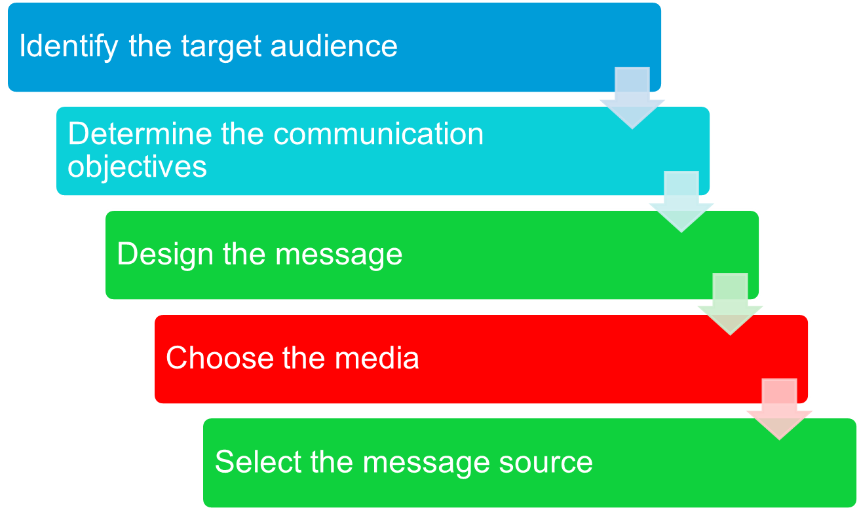
Steps in Developing Effective Marketing Communication

Slide 17
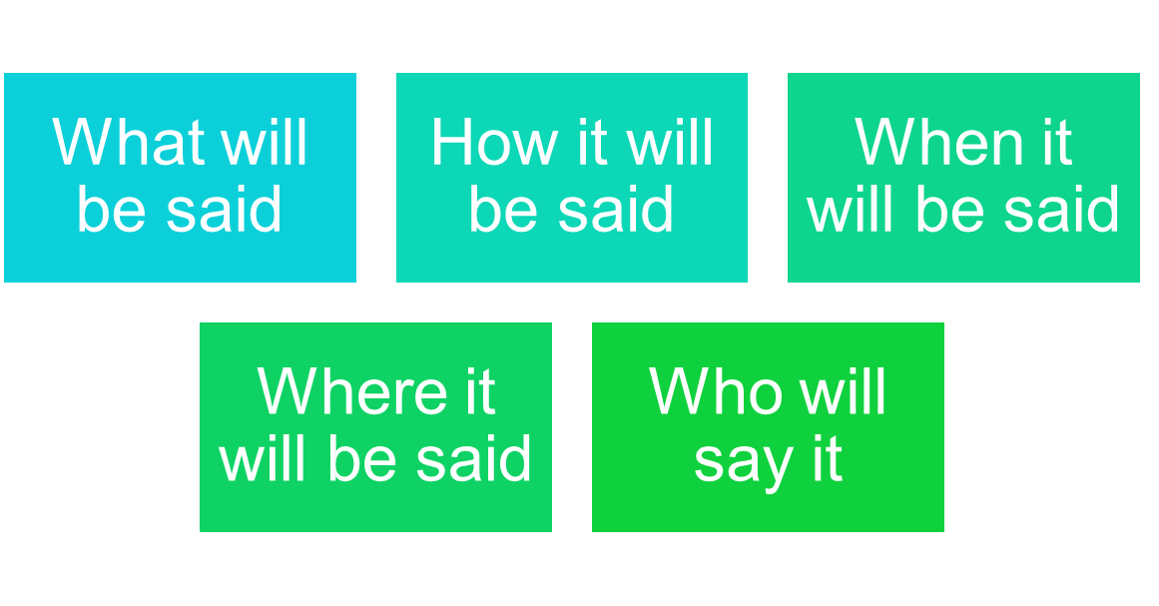
Steps in Developing Effective Marketing Communication
Identifying the Target market

Slide 18
Steps in Developing Effective Marketing Communication
Determining the Communication Objectives
Marketers seek a purchase response that results from a consumer decision-making process that includes the stages of buyer readiness

Slide 19
Steps in Developing Effective Marketing Communication
Designing a Message
AIDA Model
Get Attention
Hold Interest
Arouse Desire
Obtain Action

Slide 20
Steps in Developing Effective Marketing Communication
Designing a Message
Message content is an appeal or theme that will produce the desired response
Rational appeal
Emotional appeal
Moral appeal

Slide 21
Steps in Developing Effective Marketing Communication
Designing a Message
Rational appeal relates to the audience’s self-interest
Emotional appeal is an attempt to stir up positive or negative emotions to motivate a purchase

Slide 22
Steps in Developing Effective Marketing Communication
Designing a Message
Moral appeal is directed at the audience’s sense of right and proper

Slide 23







Step 3. Designing a Message
Steps in Developing Effective
Communication
Message Content
Rational Appeals
Emotional Appeals
Moral Appeals
Message Structure
Draw Conclusions
Argument Type
Argument Order
Message Format
Headline, Copy, Color,
Words, & Sounds,
Body Language
Attention
Interest
Desire
Action
Notes:
Designing a Message
This CTR relates to the discussion on p. 426-428.
Choosing a Message
Marketers must make decisions in several areas when choosing or creating a message, include areas related to Message Content, Message Structure, and Message Format. Key message content decisions include one of three types of appeals:
Rational Appeals. These relate to the audience’s self-interest. Rational appeals are grounded in objective, logical reasons for purchasing a product such as improved performance, increased quality, better reliability, and increased productivity.
Emotional Appeals. These attempt to elicit either positive or negative feelings that will facilitate a purchase.
Moral Appeals. These are directed to the consumer’s sense of right and wrong and are often used in conjunction with the marketing of social causes. To be effective, marketers must very narrowly and very accurately target their consumer market. Moral appeals may work extremely well with groups that share the same morals, but will very likely outrage groups whose moral values differ from those in the message.
Message Structure
Marketers deal with three message structure issues.
Conclusions. First, marketers must decide whether or not to draw a conclusion in the message. Effectiveness depends upon both the nature of the information being communicated and the relative level of experience with the product concept on the part of the audience.
Argument Type. Second, marketers must decide on the type of argument to be used: One-sided arguments or Two-sided arguments .
Argument Order. Third, argument order must be decided. When many arguments are being used, placing the strongest argument either first or last can affect persuasiveness.
Marketers must also make message format decisions. Format issues involve sensory qualities, color in visual ads, sound in radio, and effective use of novelty and contrast in the message.

Slide 24
Factors in Developing Promotion Mix Strategies
Push Strategy - “Pushing” the Product Through Distribution Channels to Final Consumers.
Pull Strategy - Producer Directs It’s Marketing Activities Toward Final Consumers to Induce Them to Buy the Product.
Type of Product/ Market
Product Life-Cycle Stage
Buyer/ Readiness Stage
Notes:
Factors in Developing Promotion Mix Strategies
This CTR relates to the material on pp. 435-437.
Factors in Setting the Promotion Mix
Push or Pull Strategy. The promotion mix is also affected by the company's decision on either a push or pull strategy. Push strategies rely on personal selling and sales promotions to encourage intermediaries to take the product and promote, thus "pushing" it through the channel. Pull strategies rely on advertising and consumer promotions to build up demand in the target market of ultimate consumer whose behavior effectively "pulls" the product through the channel.
Type of Market. The type market, consumer or industrial, varies the importance of the promotion tools available to marketers. Advertising weighs heavily in consumer markets whereas personal selling plays the greatest role in industrial markets.
Buyer Readiness State. The buyer will be more receptive to some promotion tools than others depending upon their particular buyer readiness state. Advertising and public relations help create awareness and increase knowledge. Liking and preference are more affected by personal selling and advertising together. Conviction and purchase come first from advertising and then personal selling to close depending upon the kind of product being considered.
Product Life Cycle Stage. The stage in the product life cycle also describes different appropriate promotion mix variations. Introduction utilizes advertising and public relations to build awareness and personal selling to facilitate motivate channel members to carry it. In growth, the need for personal selling diminishes. In maturity, personal selling helps differentiate it again in distribution. In decline, sales promotion may be the most emphasized of the promotion mix tools.

Slide 25
Steps in Developing Effective Marketing Communication
Choosing Media
Personal communication involves two or more people communicating directly with each other
Face to face
Phone
Mail
E-mail
Internet chat

Slide 26
Steps in Developing Effective Marketing Communication
Choosing Media
Personal communication is effective because it allows personal addressing and feedback
Control of personal communication
Company
Independent experts
Word-of-mouth

Slide 27
Steps in Developing Effective Marketing Communication
Choosing Media
Personal Communication
Opinion leaders are people within a reference group who, because of their special skills, knowledge, personality, or other characteristics; exerts social influence on others
Buzz marketing involves cultivating opinion leaders and getting them to spread information about a product or service to others in their communities

Slide 28
Steps in Developing Effective Marketing Communication
Nonpersonal Communication Channels
Nonpersonal communication is media that carry messages without personal contact or feedback, including major media and events that affect the buyer directly

Slide 29
Steps in Developing Effective Marketing Communication
Nonpersonal Communication Channels
Major media include print, broadcast, display, and online media
Atmospheres are designed environments that create or reinforce the buyer’s leanings toward buying a product
Notes:
ATL BTL

Slide 30
Steps in Developing Effective Marketing Communication
Nonpersonal Communication Channels
Events are staged occurrences that communicate messages to target audiences
Press conferences
Grand openings
Exhibits
Public tours

Slide 31
Steps in Developing Effective Marketing Communication
Selecting the Message Source
The message’s impact on the target audience is affected by how the audience views the communicator
Celebrities
  Athletes
  Entertainers
Professionals
  Health care providers

Slide 32
Steps in Developing Effective Marketing Communication
Collecting Feedback
Involves the communicator understanding the effect on the target audience by measuring behavior resulting from the actions

Slide 33
Setting the Total Promotion
Budget and Mix
Setting the Total Promotion Budget
Affordable budget method sets the budget at an affordable level
Ignores the effects of promotion on sales

Slide 34
Setting the Total Promotion
Budget and Mix
Setting the Total Promotion Budget
Percentage-of-sales method sets the budget at a certain percentage of current or forecasted sales or unit sales price
Easy to use and helps management think about the relationship between promotion, selling price, and profit per unit
Wrongly views sales as the cause rather than the result of promotion

Slide 35
Setting the Total Promotion
Budget and Mix
Setting the Total Promotion Budget
Competitive-parity method sets the budget to match competitor outlays
Represents industry standards
Avoids promotion wars

Slide 36
Setting the Total Promotion
Budget and Mix
Setting the Total Promotion Budget
Objective-and-task method sets the budget based on what the firm wants to accomplish with promotion and includes:
Defining promotion objectives
Determining tasks to achieve the objectives
Estimating costs

Slide 37
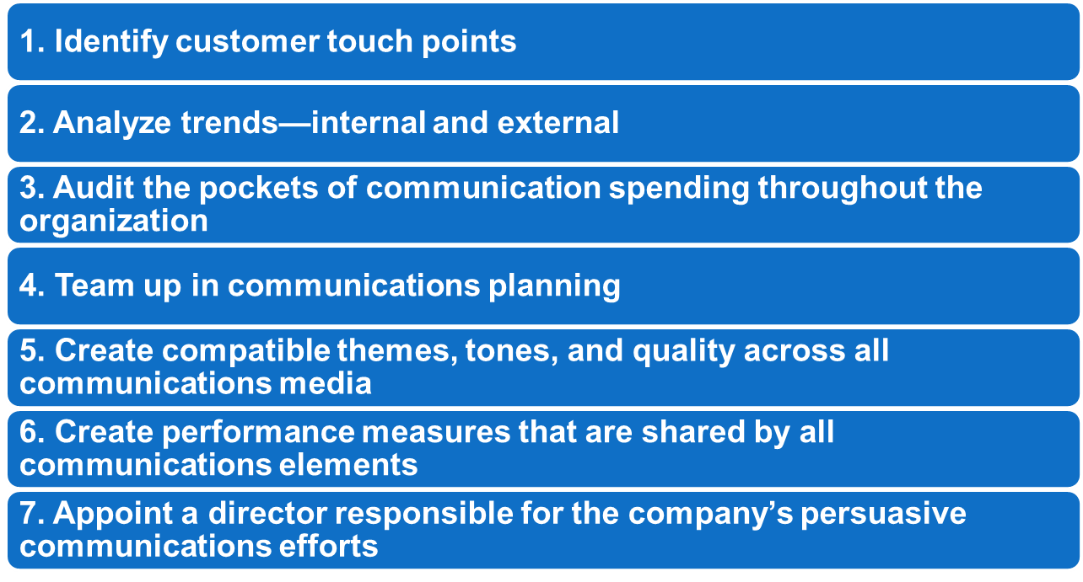
Setting the Total Promotion
Budget and Mix
Integrating the Promotion Mix
Checklist

Slide 38
Socially Responsible Marketing Communication
Communicate openly and honestly with consumers and resellers
Avoid deceptive or false advertising
Avoid bait-and-switch advertising
Conform to all federal, state, and local regulations
Follow rules of “fair competition”
Do not offer bribes
Do not attempt to obtain competitors’ trade secrets
Do not direspect competitors or their products

